Slide 1

Memory and Systems

Slide 2
Recap
Context is limited, useful context is even more limited
  Context Engineering: How should we structure the context to make the necessary information readily available
Retrieval Augmented Generation
  Latent knowledge is not always adequate, retrieving the “right” information makes agents more accurate and reliable
How do we use RAG to keep to conversation (campaign) conherent?
How do we decide what to store?

Slide 3
Two Scenarios: Long Conservations
You are conversing with an agent for days/weeks/months
Need to refer to previous conversations (sessions)
“I ran into John today and he was talking about our project from last month”
  Who is John and what is his relationship to me?
  What was the project, how did it turn out?
  What is my job?

Slide 4
Two Scenarios: Long Running Campaign
Campaign that lasts days to weeks and makes thousands of tool calls
Current hypotheses and trials need to be based on results from previous simulations
  In previous sessions, the user asked me to run the simulation with 3 different seeds and 5 different configurations to validate the results, I should do that again.
  I needed this scheduler flag for the simulation to complete last time
  I’ve already tried molecule X so I don’t need to try the same molecule again
  Adding group Z improved some property in previous molecules, so I should try adding group again

Slide 5
Memory Scaling
Agents should continue to improve the longer they work
Recall information from previous sessions (for ambiguous references, previous trials, etc.)
Reduce session to session repetition
Speed up how long it takes to find the “happy path”
Reduce token/cache consumption from inferring on long context
Reduce effects of lost-in-the-middle and other context quirks

Slide 6
Coding Agent Memory
Two types of memory:
Episodic: Logs of conversations, tool-results, etc.
Semantic: Generalized take-aways from these interactions
Store previous session files
Compact conversations into usable insights

Slide 7
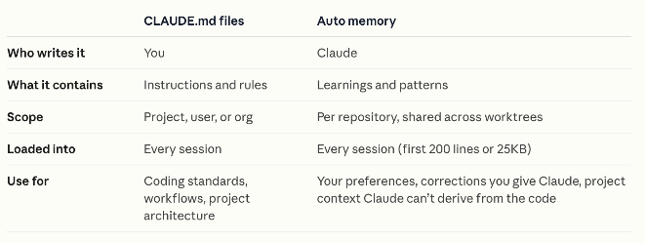
Coding Agent Memory

Slide 8
Extracting Memories via Dreaming
Traditionally: memories written actively during conversations
“Dreaming” – background process that synthesize previous conversations into memories
  Pre-existing memory store
  1-100 sessions
  Outputs a new memory store updated

Slide 9
Pattern: Compaction and Handoff Files
Ask the agent to summarize the conversation state for later resumption
Specify (via templates) insights and information necessary

Slide 10
Activity: Memory Over Conversations

Slide 11
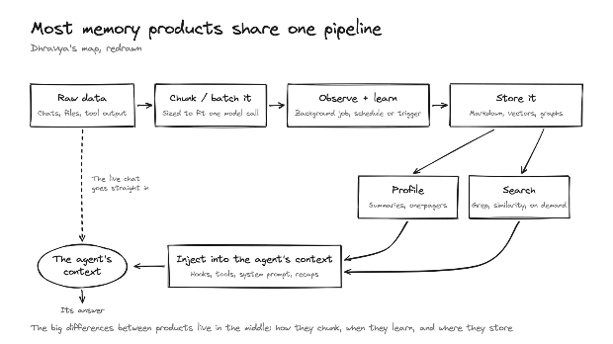
Memory Systems
How should semantic memories be extracted and structured?
How do we retrieve memories?
What context should be injected before and after retrieval?

Slide 12
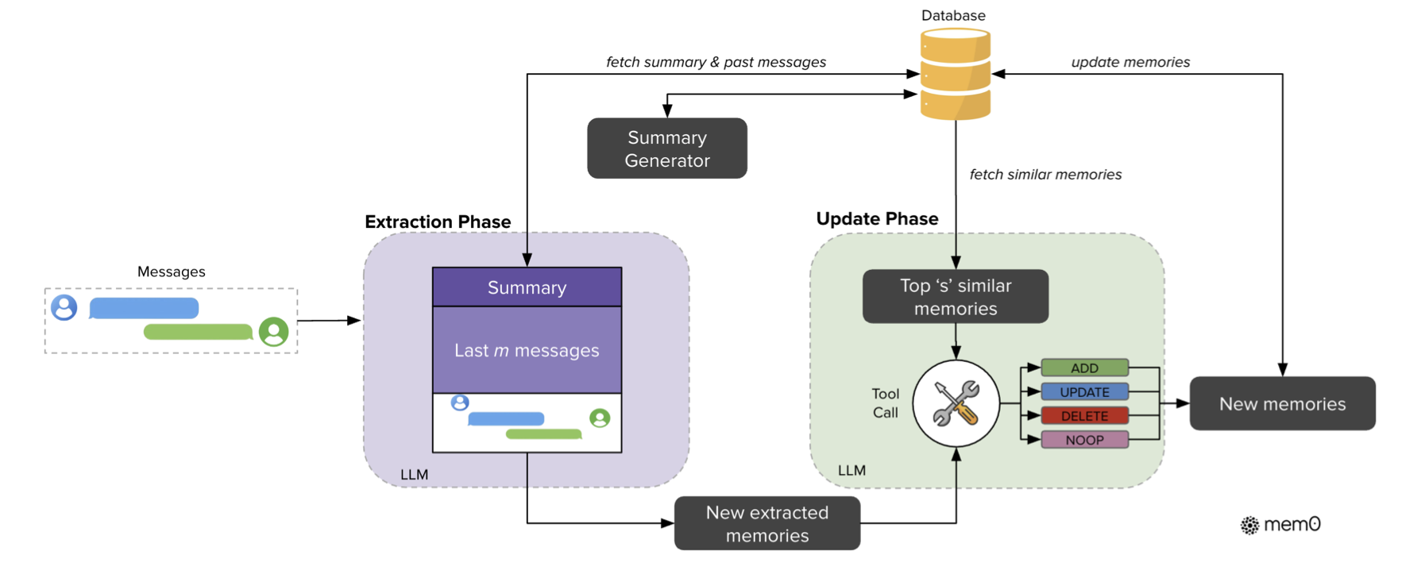
Example Memory System: Mem0
Extraction Phase: Find salient information from current message
Update Phase: Find similar memories, then add update or delete
Extraction and Update can also work on entities and relations

Slide 13
Capstone Activity
Reproducing Papers with a Coding Agent

